Slide 1
HUMAN COMPUTER INTERACTION
LECTURE 7,8

Slide 2
Models of Interaction:
Interaction involves atleast two participants- the user and the system.
Both are complex and very different from each other in the way that they communicate and view the domain and the task. The interface must therefore effectively translate between them to allow the interaction to be successful.
The use of models of interaction can help to understand what is going on in interaction and identify the likely root of difficulties. They also provide us with a framework to compare different interaction styles and to consider interaction problems.

Slide 3
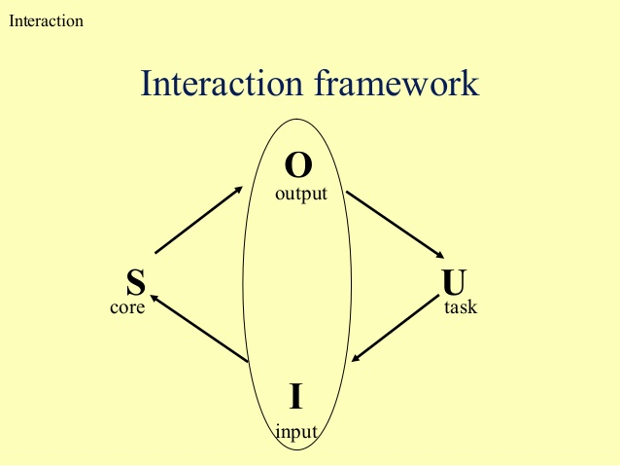

Slide 4
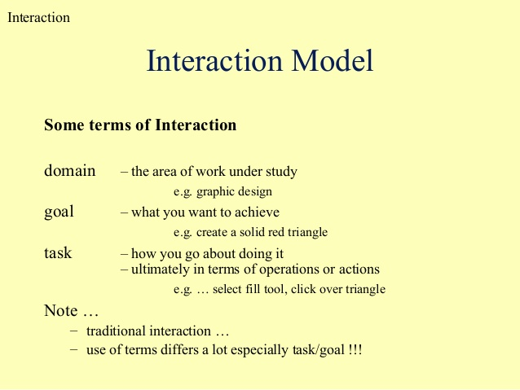

Slide 5
The execution – evaluation cycle:
Normans model of interaction is the most influential in HCI because of its closeness to understanding of the interaction between human user and computer.
The user formulates a plan of action, which is then executed at the computer interface.
When the plan, or the part of the plan, has been executed, the user observes the computer interface to evaluate the result of the executed plan to determine further actions.
The interaction cycle can be divided into two major phases: execution and evaluation.

Slide 6
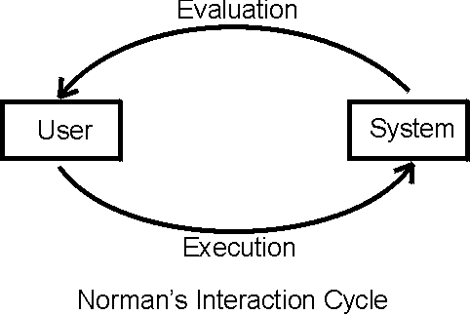

Slide 7
These can be sub-divided into seven stages.
The stages in Normans model of interaction are as follows:
Establishing the goal
Forming the intention
Specifying the action sequence
Executing the action
Perceiving the system state
Interpreting the system state
Evaluating the system

Slide 8
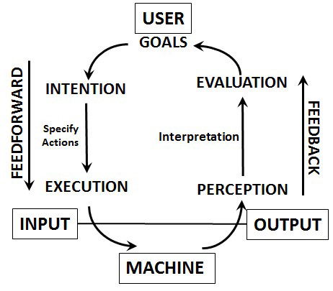

Slide 9
Each stage is an activity of user
First the user forms a goal. This is the users notion of what needs to be done and is framed in terms of the domain, in the task language.
It needs to be translated into more specific interaction, and the actual actions that will reach the goal, before it can be executed by the user.
The user perceives the new state of the system, after execution of the action sequence and interprets it in terms of his expectations.
If the system states reflects the user goals than the computer has done what user wanted and the interaction has been successful.
Normans uses this model of interaction to demonstrate why some interfaces cause problems to their users.
This is described in terms of Gulfs of execution and the Gulfs of evaluation.

Slide 10
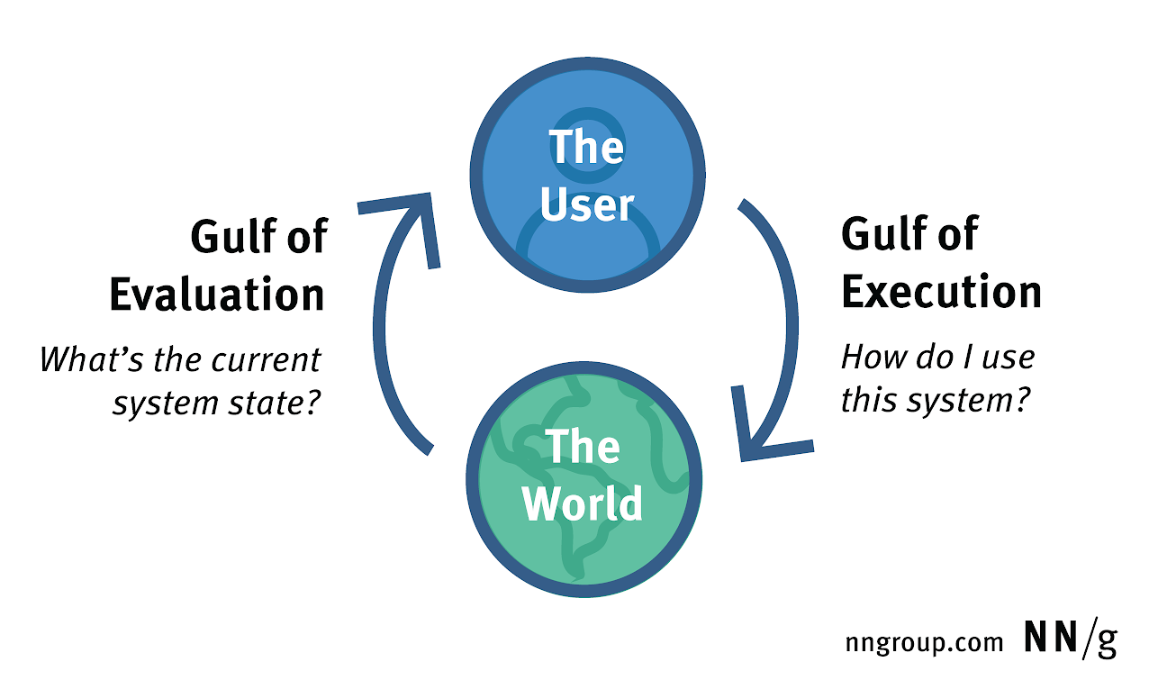

Slide 11
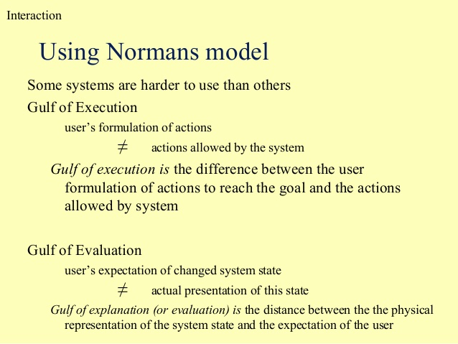

Slide 12
The Gulfs of execution is the difference between user formulation of the actions to reach the goals and the action allowed by the system.
The Gulf of evaluation is the distance between physical presentation of the system state and the expectation of the user.
If the user can readily evaluate the presentation in terms of his goal, the Gulf of evaluation is small.
The more effort that is required on the part of the user to interpret the presentation, the less effective the interaction.

Slide 13
Ergonomics:
Ergonomics is the study of physical characteristics of the interaction: how the controls are designed, the physical environment in which the interaction takes place, and the layout and physical quantities of the screen.
The primary focus is on user performance an how the interface chances this.
To evaluate these aspects of interaction, Ergonomics will touch upon human psychology and system constraints.
The Ergonomics deals about arrangement of controls and displays, the physical environment, health issues and the use of color.
These are intended only to give an indication of types of issues and problems addressed by Ergonomics.

Slide 14


Slide 15
Arrangement of controls and displays:
In additional to cognitive aspects of design, physical aspects are also important.
Sets of controls and parts of the display should be grouped logically to allow rapid access by user. Inappropriate placement of controls and displays can lead to inefficiency.
The exact organization will depend in the domain and the application but possible organization include the following:
-Functional controls and displays are organized as that functionally related are placed together.
-sequential controls and displays are organized to reflect the order of their use in interaction.
-frequency controls and displays are organized according to how frequently they are used.
In addition to the controls and displays in relation to each other , the entire system interface must be arranged appropriately in relation to the users position.

Slide 16
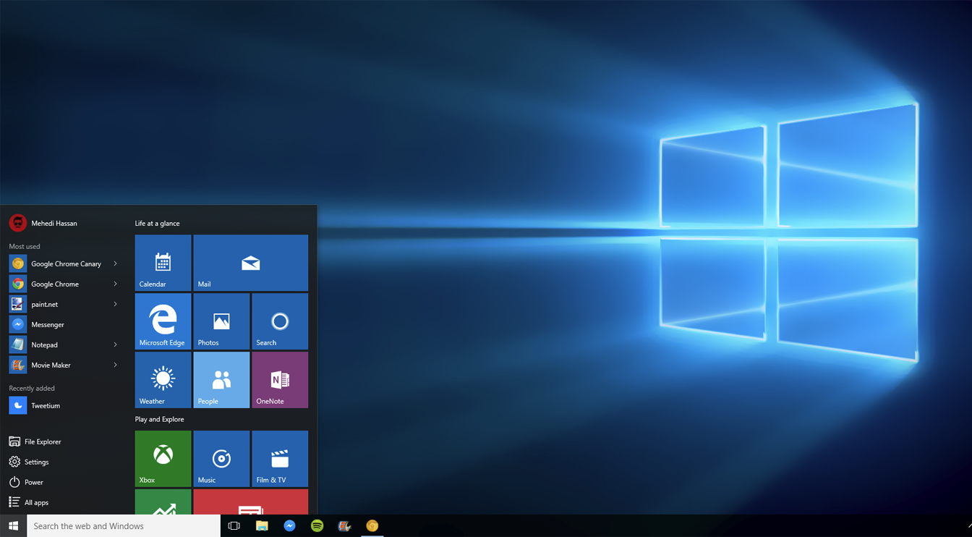

Slide 17
The Physical Environment of Interaction:
Ergonomics is also concerned with the design of work environment.
The physical environment in which the system is used may influence how well it is accepted and even the health and safety of its users.
In a system even a smallest user should be able to reach all the contexts.
All users should be compatibly able to see critical displays and users should be seated comfort for long periods of use.

Slide 18
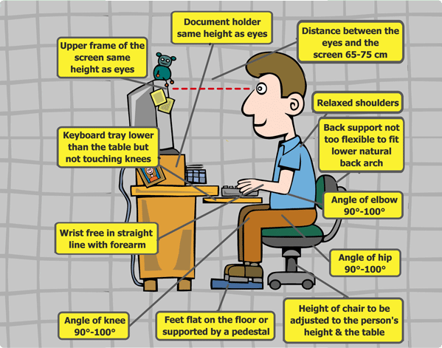

Slide 19
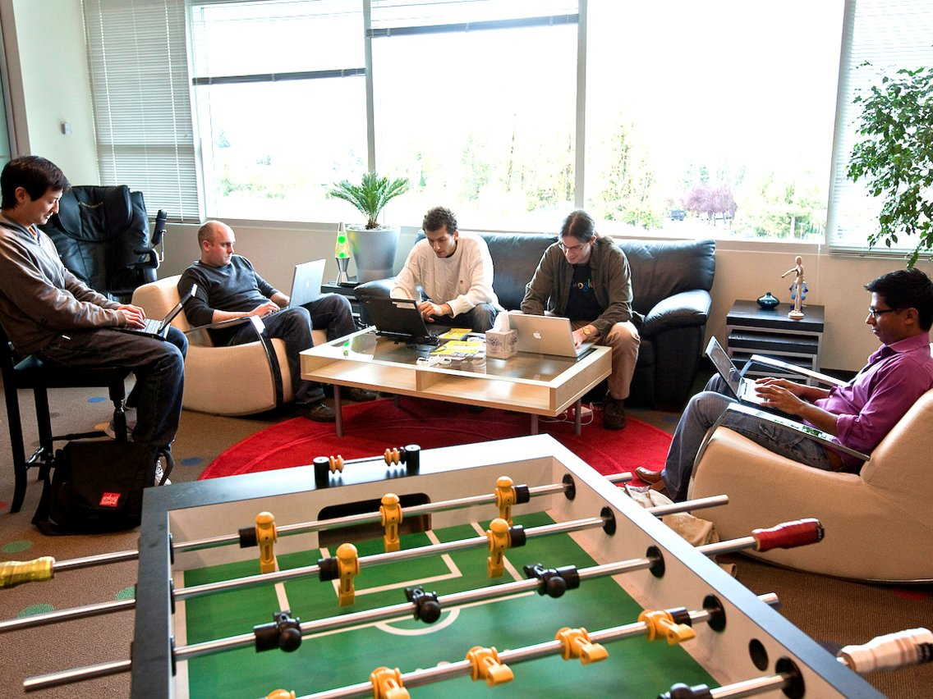
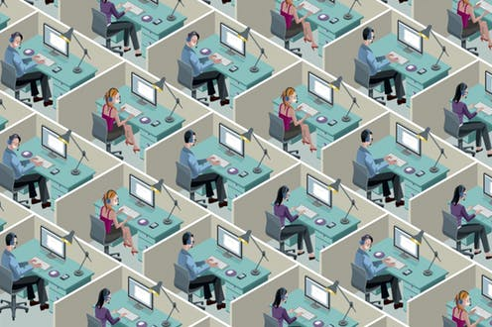

Slide 20
Health Issues- Possible consequences of our design on health and safety of users should be considered while designing interface.
There are many factors that may effect the use of poorly design interface.
These are the factors in physical environment that directly effect the quality of interaction and user performance
-Physical position – users should be able to reach all controls comfortably and see all displays.
-Temperature-experimental studies how the performance decreases at high and low temperatures with users being usable to concentrate effectively.
-Lighting -adequate lighting should be provided to allow users to see the computer screen without discomfort.
-Noise-noise levels should be maintained at a comfortable level in the work environment.
-Time- the time users spend using the system should also be controlled.

Slide 21
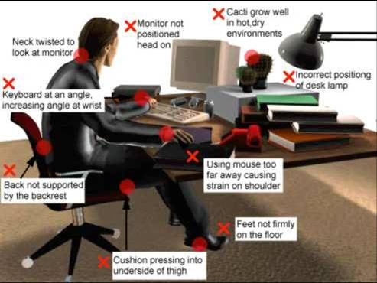

Slide 22
The Use of Color - Ergonomics has a close relationship to human psychology in that it is also concerned with the perceptual limitations of humans .
The use of color in displays is an ergonomics issue.
Colors used in the display should be as distinct as possible and the distinction should not be effected by changes in contrast.
The colors used should correspond to common conventions and user expectations.
Designers should remember that color conventions are culturally are determined.
Awareness of culture associations of color is particularly important is designing systems and websites for global market.

Slide 23
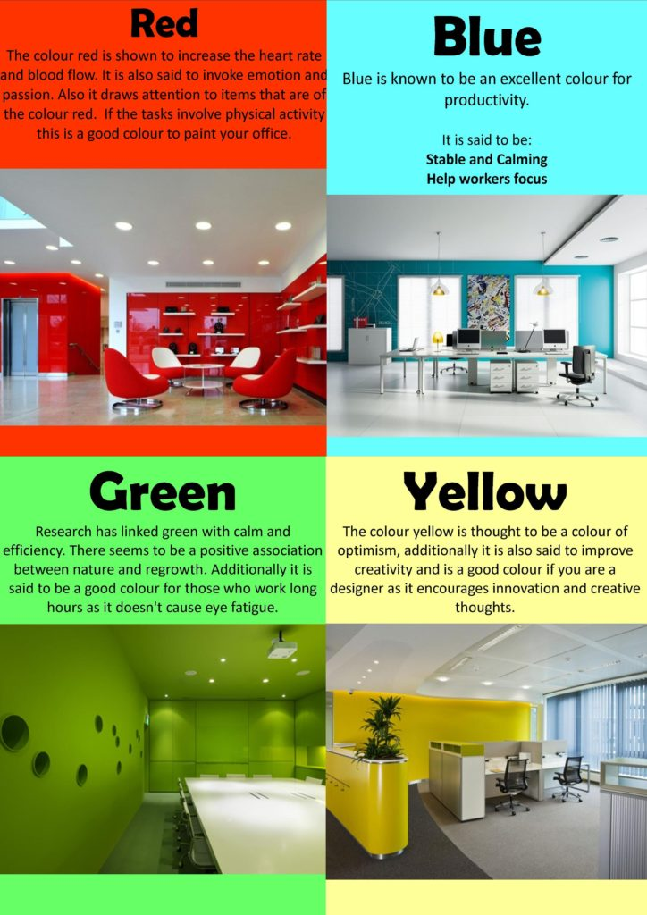

Slide 24
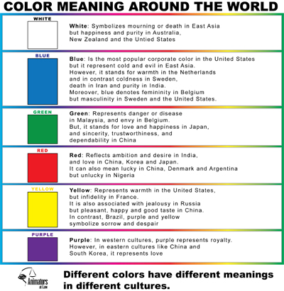

Slide 25
